Slide 1
Introduction to Excel

Slide 2
Excel
Excel is a spreadsheet program that allows one to enter numerical values or data into the rows or columns of a spreadsheet and to use these numerical entries for calculations, graphs, and statistical analyses
Spreadsheet – is the computer equivalent of a paper ledger sheet. It consists of a grid made from columns and rows.
The spreadsheet environment can make number manipulation easy and somewhat painless.
The advantage of Excel is that you can experiment with numbers without having to RE-DO all of the calculations. LET THE COMPUTER DO IT FOR YOU!!

Slide 3
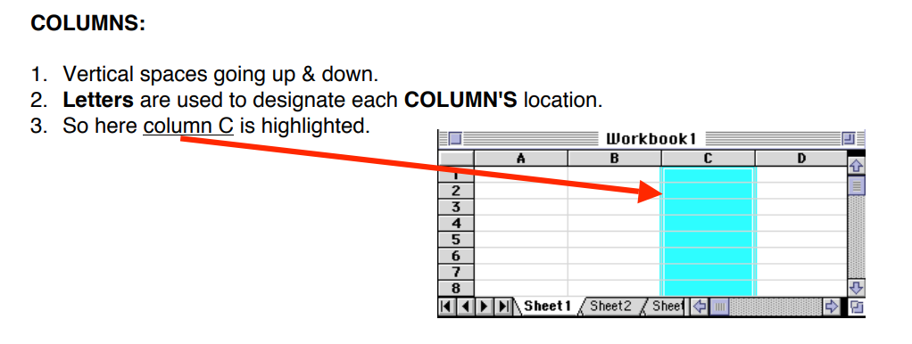
Spreadsheet Basics
Spreadsheets are made up of…
Columns
Rows
Cells

Slide 4
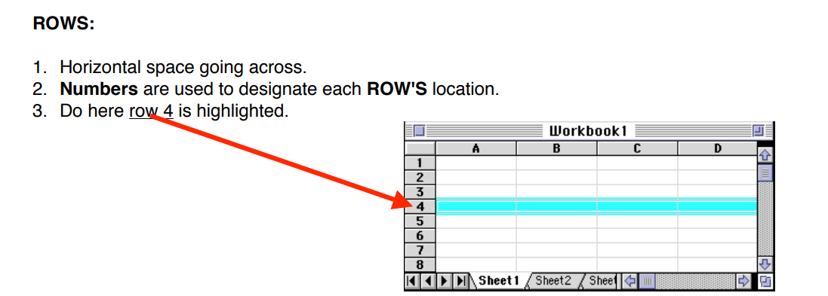
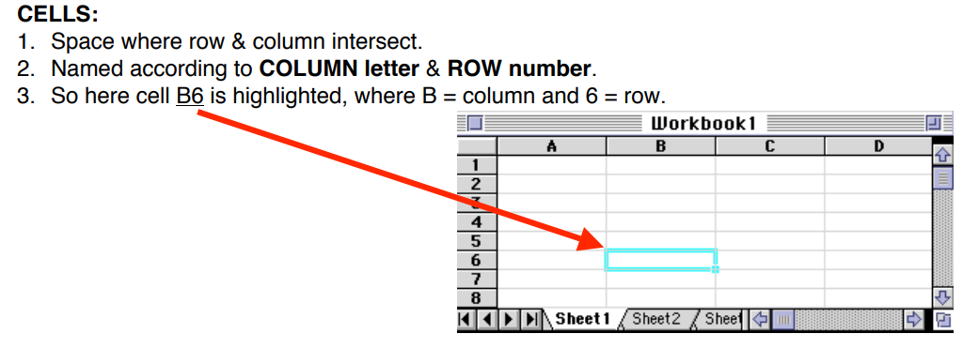

Slide 5
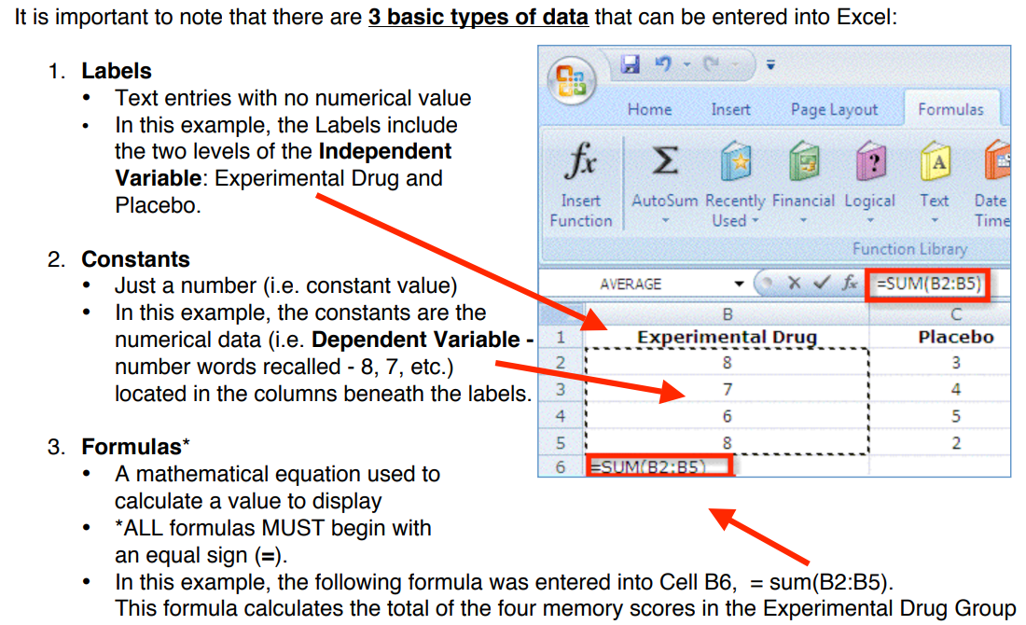
Types of Data

Slide 6
Using Excel to calculate Descriptive Statistics
Formulas or Functions
Remember that when creating formulas or functions, it is important that you BEGIN it with an equals sign (=).
Common functions that you will use,
The Sum function
The Average function
The Standard Deviation function
A list of formulas or functions is available within Excel under the menu Formula, down to Insert Function
You can also manually insert formulas by typing them directly into the cell where you want the result of the formula to appear.

Slide 7
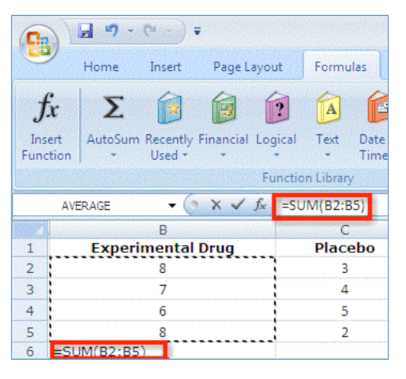
The SUM Function (SUM)
The SUM Function takes all of the values in each of the specified cells and totals their values.
For example: to get the sum of all the experimental drug group

Slide 8
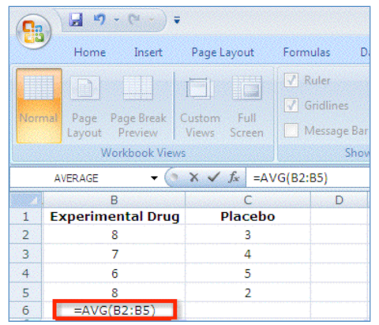
The AVERAGE function (AVG)
The AVERAGE is a measure of central tendency and gives you an idea of the typical score.
For example: to get the average of the experimental group

Slide 9
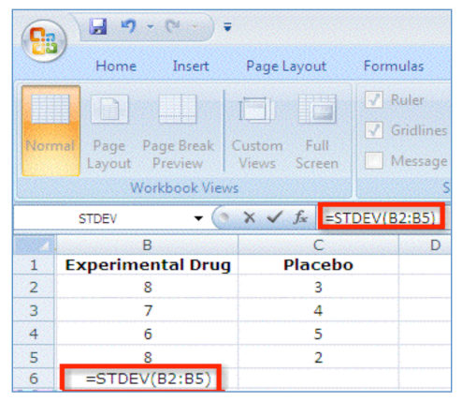
Standard Deviation Function (STDEV)
This function finds the standard deviation of the specified data. The standard deviation is a measure of the spread of variance of the data and gives you an idea of how different each score is from the average.
For example – to get the standard deviation of experimental drug group

Slide 10
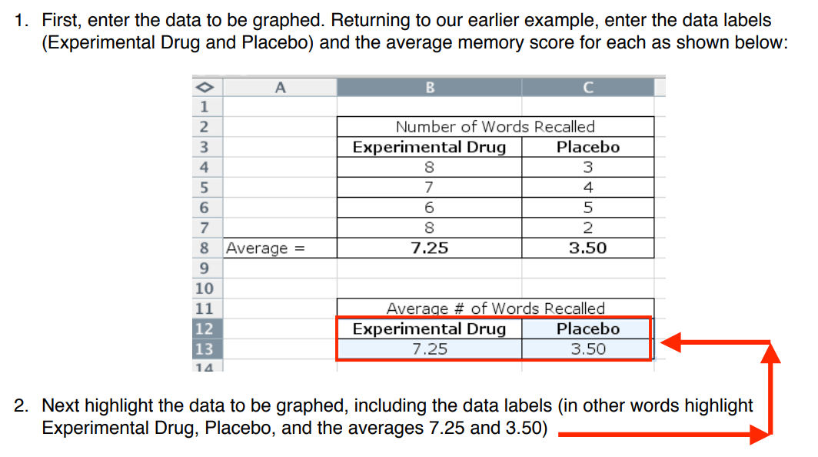
Making a Chart using Excel 2007 or Newer version
Another important feature of Excel is the Chart – also called a graph.

Slide 11
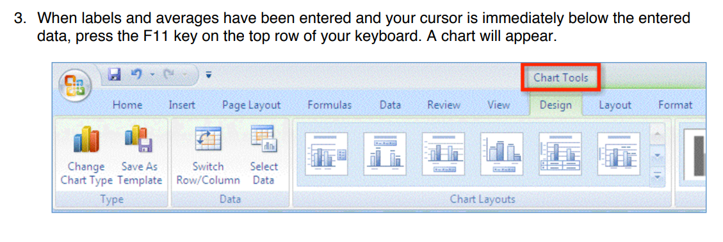
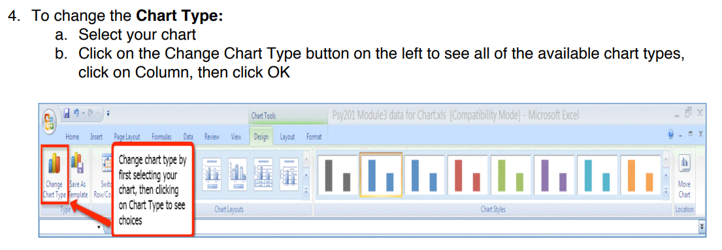

Slide 12
